Slide 1
CWC PCC
Team CWC-PCC 21Su01
Yuanhua Zhao, Yuxuan Gu

Slide 2
Project Description
Sponsor: David Willy
Client: Northern Arizona University’s Energy Club
This project will extend the capabilities of the current CWC PCC data collection system for micro-wind turbines. Specifically, the project will add in a more flexible load option and higher resolution acquisition for characterizing solar cells and thermoelectric generators that would be used for Energy Club outreach activities. The current system collects voltage, current, wind speed, temperature, and pressure to characterize wind turbines. See photos for existing system for characterizing wind turbines.

Slide 3
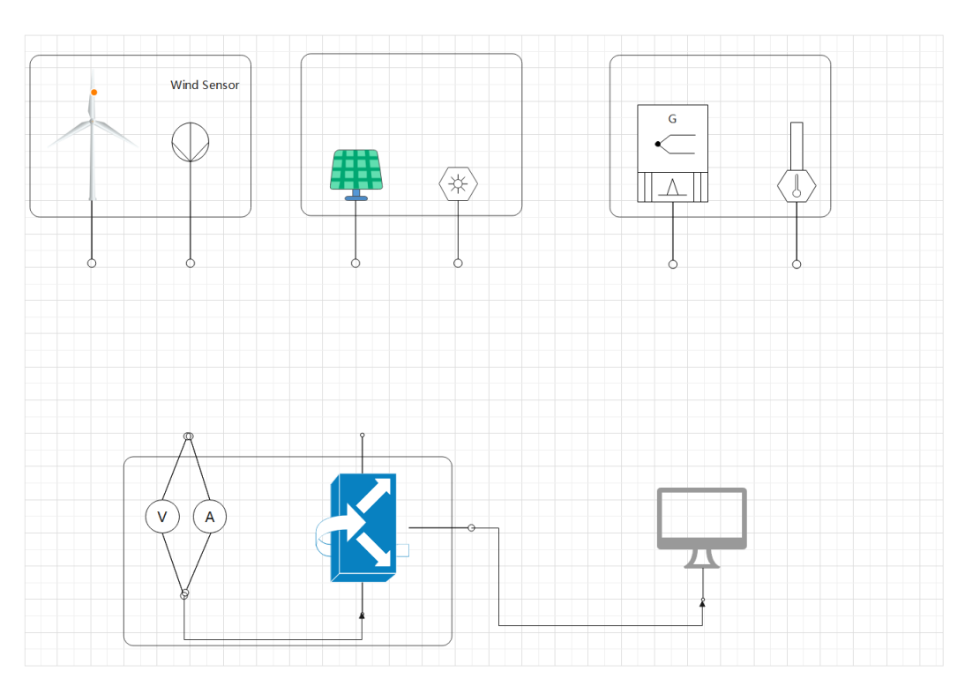
Design Description
Wind turbine System
Solar Power System
Thermoelectric System
Data collection system

Slide 4
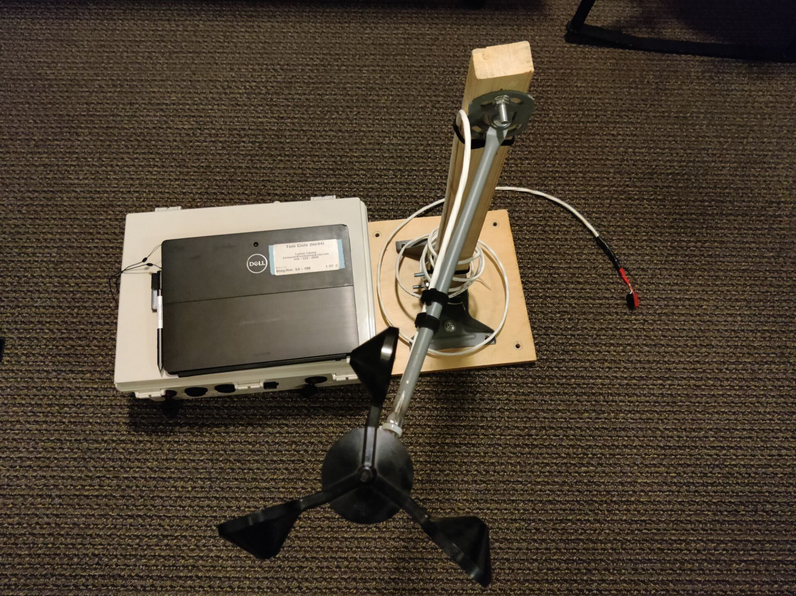
Current State of System
ERs
Weight
Size
Simple operating system
Test interface
Modularization
Durability
Price
Reliability
Fig.1 Current Analysis & Wind Turbine Subsystem

Slide 5
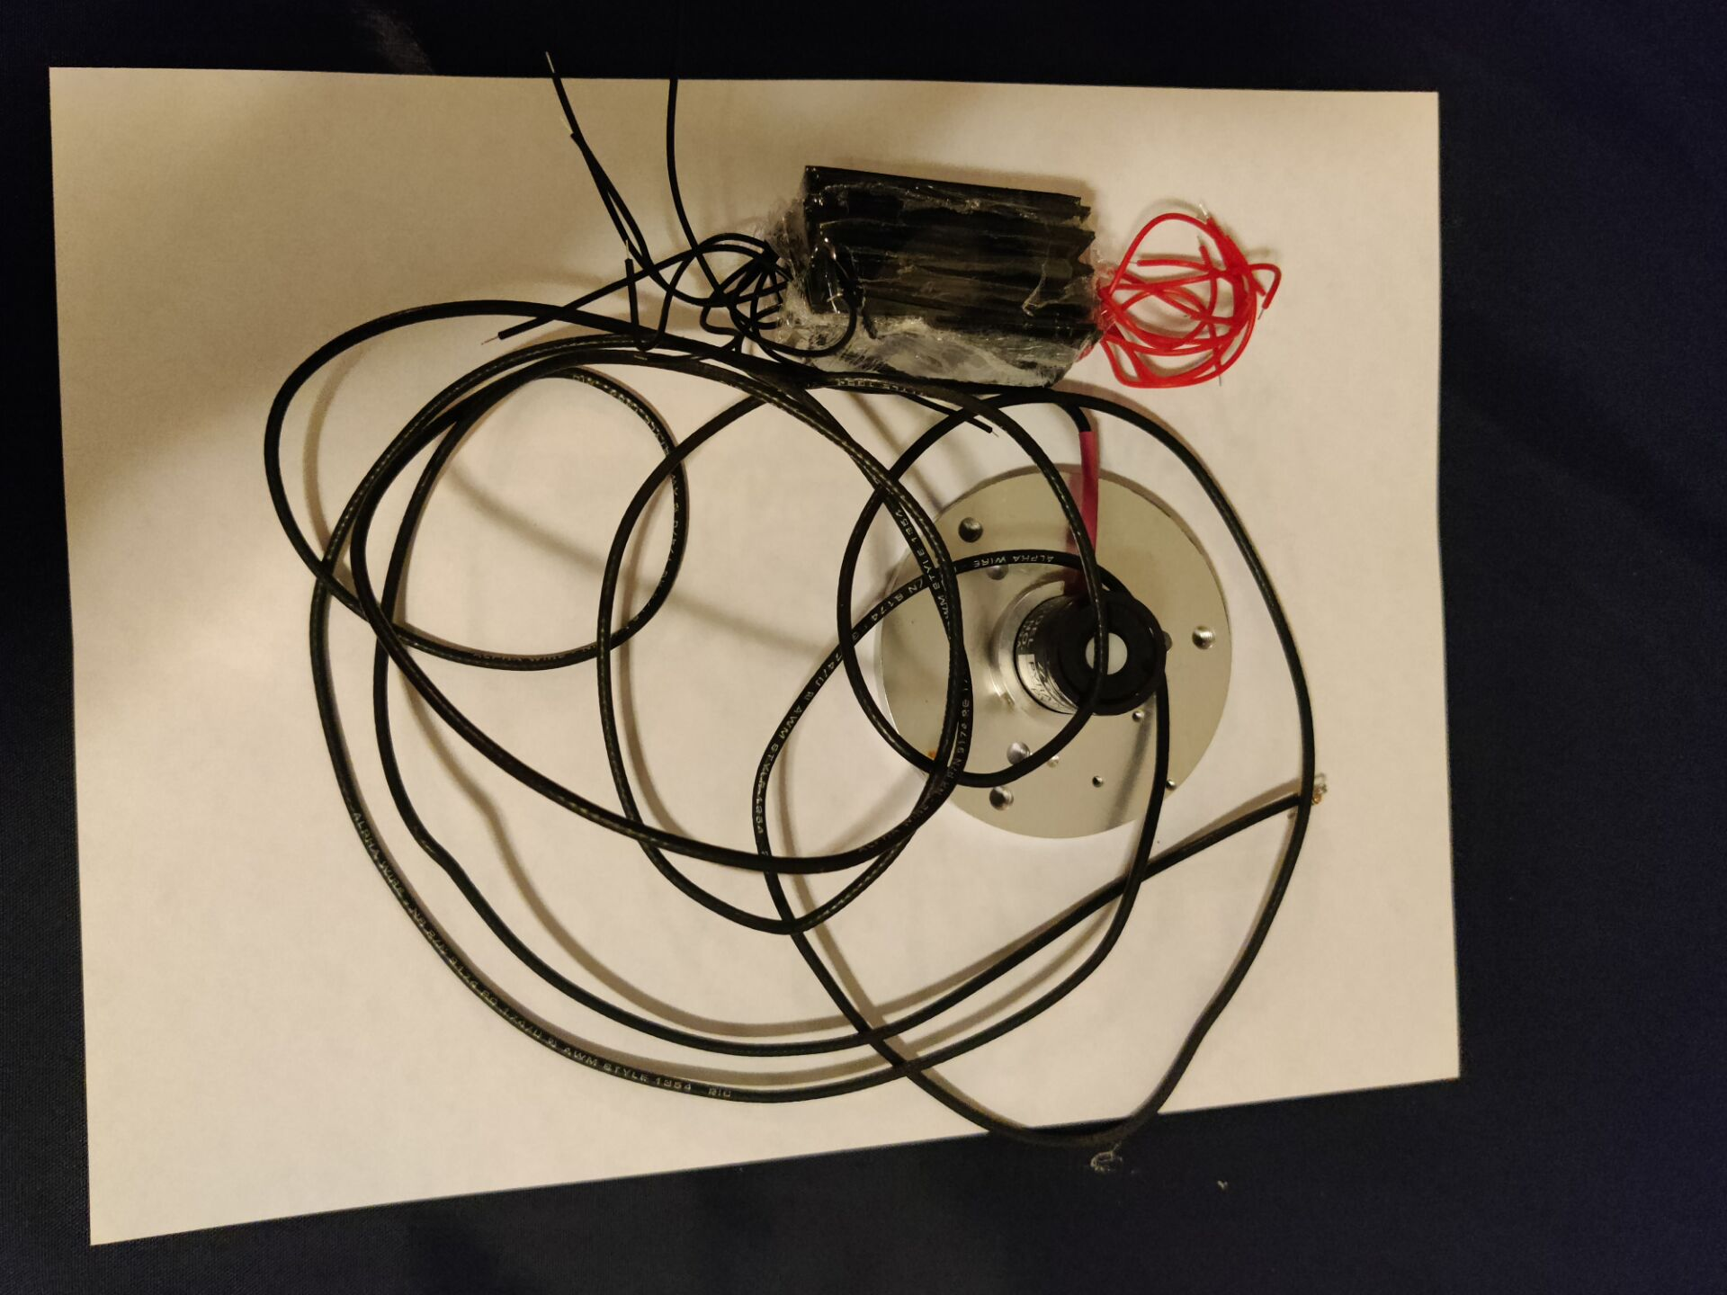
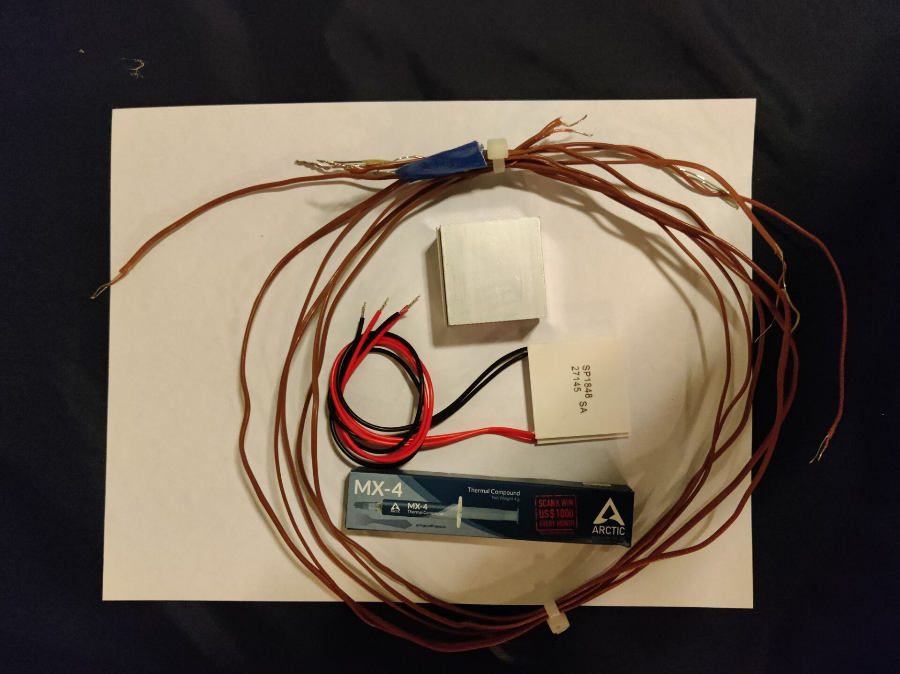
Current State of System
Fig 2. Solar Panel Subsystem
Fig 3 . TEG Subsystem

Slide 6
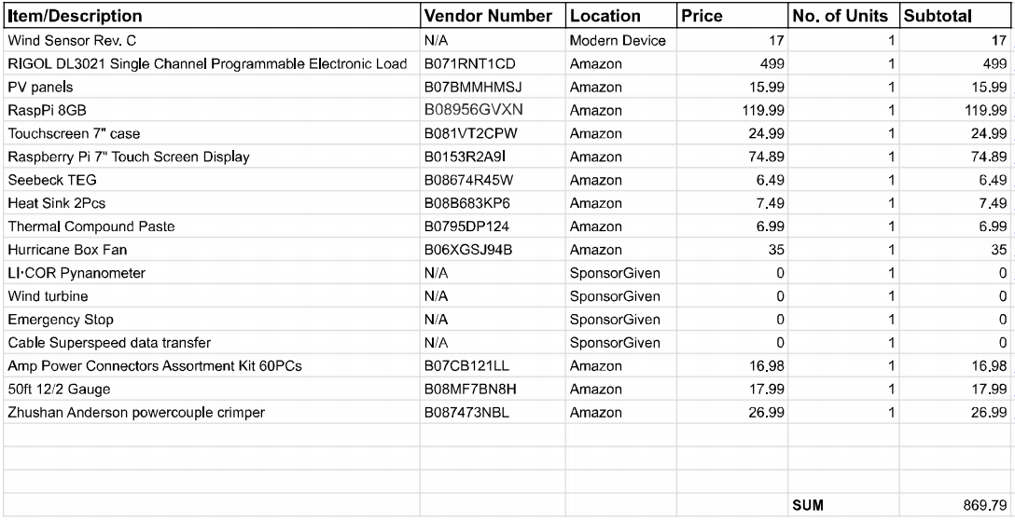
Current State of System
Current BOM

Slide 7
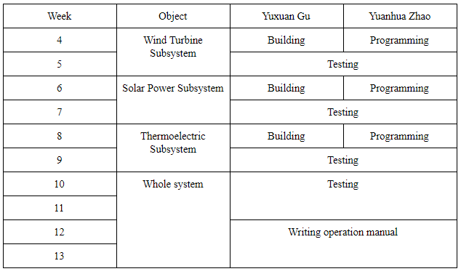
Implementation plan

Slide 8
Testing Plan
ER:
Weight
Size
Modularization
Accuracy / Error
Maintenance

